Slide 1

Agile Software Development (TCS 855)
Dynamic Software Development Method (DSDM)
Prof.(Dr.) Santosh Kumar
Department of Computer Science and Engineering
Graphic Era Deemed to be University, Dehradun

Slide 2
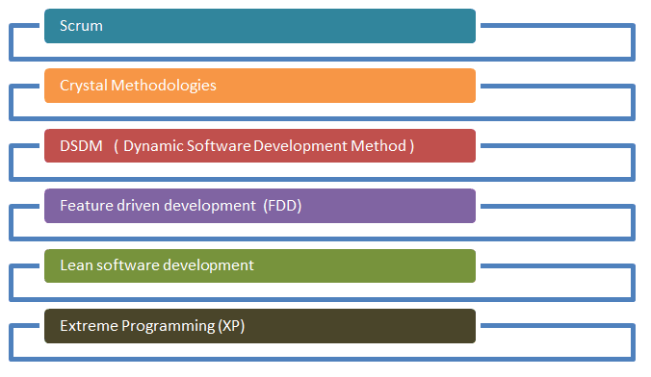
Agile Process Model
Figure: Agile Process Model

Slide 3
Dynamic Software Development Method (DSDM)
DSDM is a Rapid Application Development (RAD) approach to software development and provides an agile project delivery framework.
The important aspect of DSDM is that the users are required to be involved actively, and the teams are given the power to make decisions.
Frequent delivery of product becomes the active focus with DSDM. The techniques used in DSDM are
Time Boxing
MoSCoW Rules
Prototyping

Slide 4
Time Boxing
A timebox is a previously agreed period of time during which a person or a team works steadily towards completion of some goal.
Rather than allow work to continue until the goal is reached, and evaluating the time taken, the timebox approach consists of stopping work when the time limit is reached and evaluating what was accomplished.
Timeboxes can be used at varying time scales.
The “pomodoro technique” organizes personal work around 25-minute timeboxes.
In a completely different domain “speed Dating” is known for its seven-minute timeboxes. Time scales ranging from one day to several months have been used.
The critical rule of timeboxed work is that work should stop at the end of the timebox, and review progress: has the goal been met, or partially met if it included multiple tasks.

Slide 5
Origins
Timeboxed iterations are a distinctive feature of the early Agile approaches, notably Scrum and Extreme Programing , but they have an earlier history:
1988: the “timebox” is described as a cornerstone of Scott Schultz’s “Rapid Iterative Production Prototyping” approach in use at a Du Pont spin-off, Information Engineering Associates
1991: the details of the “timebox” are described at length in one chapter of James Martin’s “ Rapid Application Development”.

Slide 6
MoSCoW Rules
In a DSDM project where time has been fixed, it is vital to understand the relative importance of the work to be done in order to make progress and keep to deadlines.
Prioritisation can be applied to requirements/User Stories, tasks, products, use cases, acceptance criteria and tests, although it is most commonly applied to requirements/ User Stories.
User Stories are a very effective way of defining requirements in an Agile style; see later chapter on Requirements and User Stories for more information.
MoSCoW is a prioritisation technique for helping to understand and manage priorities. The letters stand for:
Must Have
Should Have
Could Have
Won’t Have this time
MoSCoW (Must Have, Should Have, Could Have, Won't Have this time) is primarily used to prioritise requirements, although the practice is also useful in many other areas.

Slide 7
Must Have
These provide the Minimum Usable SubseT (MUST) of requirements which the project guarantees to deliver. These may be defined using some of the following:
No point in delivering on target date without this; if it were not delivered, there would be no point deploying the solution on the intended date
Not legal without it
Unsafe without it
Cannot deliver a viable solution without it
Should Have: Should Have requirements are defined as:
Important but not vital
May be painful to leave out, but the solution is still viable
May need some kind of workaround, e.g. management of expectations, some inefficiency, an existing solution, paperwork etc. The workaround may be just a temporary one

Slide 8
Could Have: Could Have requirements are defined as:
Wanted or desirable but less important
Less impact if left out (compared with a Should Have)
Won’t Have this time
These are requirements which the project team has agreed will not be delivered (as part of this timeframe).
They are recorded in the Prioritised Requirements List where they help clarify the scope of the project.

Slide 9
The DSDM project consists of 7 phases
Pre-project
Feasibility Study
Business Study
Functional Model Iteration
Design and build Iteration
Implementation
Post-project

